Slide 1

.
Notes:
1

Slide 2

嶄新的公司：化繁為簡的致勝策略
A New Company: Keeping the UnFranchise™ Business Simple
Veronica Ng
業務拓展及傳訊經理
Sales & Communications Manager

Slide 3



Slide 4
化繁為簡及提升
Simplify & Improve

Slide 5
持續令招募、推薦及發展事業變得更簡單的程序和計劃
Ongoing process and plan of making it faster and easier to recruit and retail to grow our business.

Slide 6
成功五要訣
Basic 5

Slide 7
產生效益的活動
使用及銷售產品
宣傳事業
賣票
在家工作
Result Producing Activities
Use and sell the Products
Introducing the Business
Sell Tickets
Work in the homes

Slide 8
化繁為簡的各項措施：
快速起步套裝（基本、Motives、TLS健康生活纖營計劃）
全新UBP簡報
立即加入 / 等候室(Waiting Room)
自動年度續約
全新起步指南
全新美安集團簡介資料
Accomplishments to simplify the business:
Fast Start program (General, Motives and TLS)
New UBP PowerPoint presentation
Partner Now / Waiting Room
Auto Annual Renewal
New Getting Started Guide
New About MA document

Slide 9
化繁為簡的各項措施：
自動購貨產品預設
自動送貨
全新簡化起步窗口
MP4播放器
在入會窗口購買主要會議門票
全新簡化入會窗口
Accomplishments to simplify the business:
Transfer buying autofill
Autoship
New, simplified Getting Started Wizard
MP4 player
Major event ticket purchase within sign up wizard
New, simplified Sign Up Wizard

Slide 10
化繁為簡的各項措施：
全新簡化物色短片‘I’m an Entrepreneur’
產品組合套裝
網上訓練（新經銷商訓練、成功五要訣）
顧客免費送貨
1000表格提交截止時間11:59pm
Accomplishments to simplify the business:
New, simple prospecting video ‘I’m an Entrepreneur’
Product kits
Online training (NDT, B5)
Free shipping for customers
Form 1000 – 1:59pm → 11:59pm

Slide 11
還可變得更好嗎？
Can it get any better?

Slide 12
化繁為簡及提升
Simplify & Improve

Slide 13
全新入會登記窗口
New Sign Up Wizard

Slide 14
全新提升及功能包括：
所有國家使用相同入會登記窗口程序
現在，無論你是否擁有全球推薦權，亦可於任何國家推薦新經銷商。這是unfranchise.com一體化的第一步
現在，所有國家的入會登記窗口都支援直接於新興市場計劃(EMP)推薦新經銷商，而無需推薦人使用立即加入程序（此程序不適用於零售商）
New enhancements & features include:
Same sign up wizard process for all countries
You can now sponsor someone in any country regardless if you are global there or not. This is one of the first steps towards the unfranchise.com unification.
The signup wizard for all countries now supports the ability to sponsor directly into EMP countries instead of the sponsor having to use the Partner Now process (which didn’t support sales reps).

Slide 15
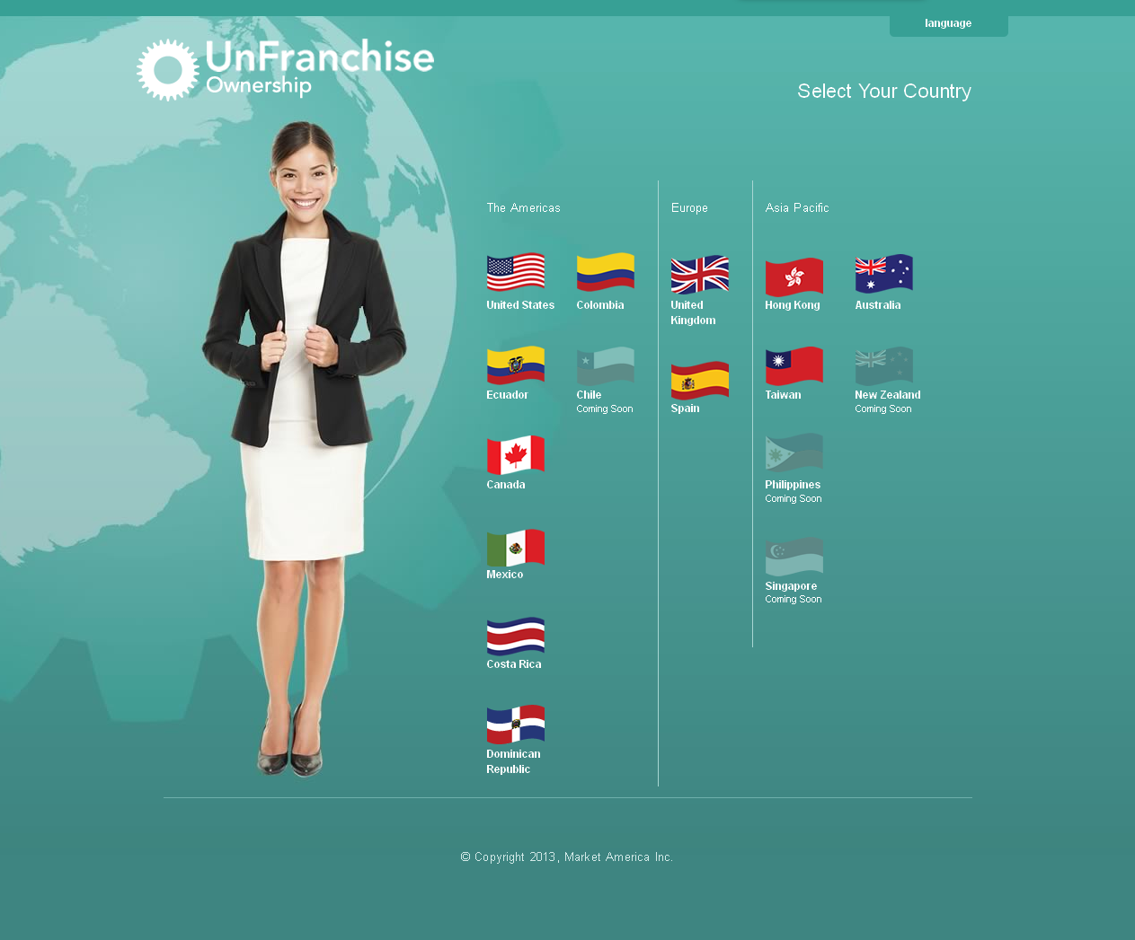
全新、提升版、更快、更簡易的
入會登記窗口
Introducing the New,
Improved, faster, simpler Sign-Up Wizard

Slide 16
新入會登記窗口功能：
所有國家相同設計
超連鎖店主只需點擊版面所示的任何國旗，即可為該國家的經銷商開始入會登記
Updated Sign-Up Wizard Features:
Same design for all countries
A UnFranchise owner can start the sign-up process for a new Distributor from any country just by clicking on the country flag screen.

Slide 17
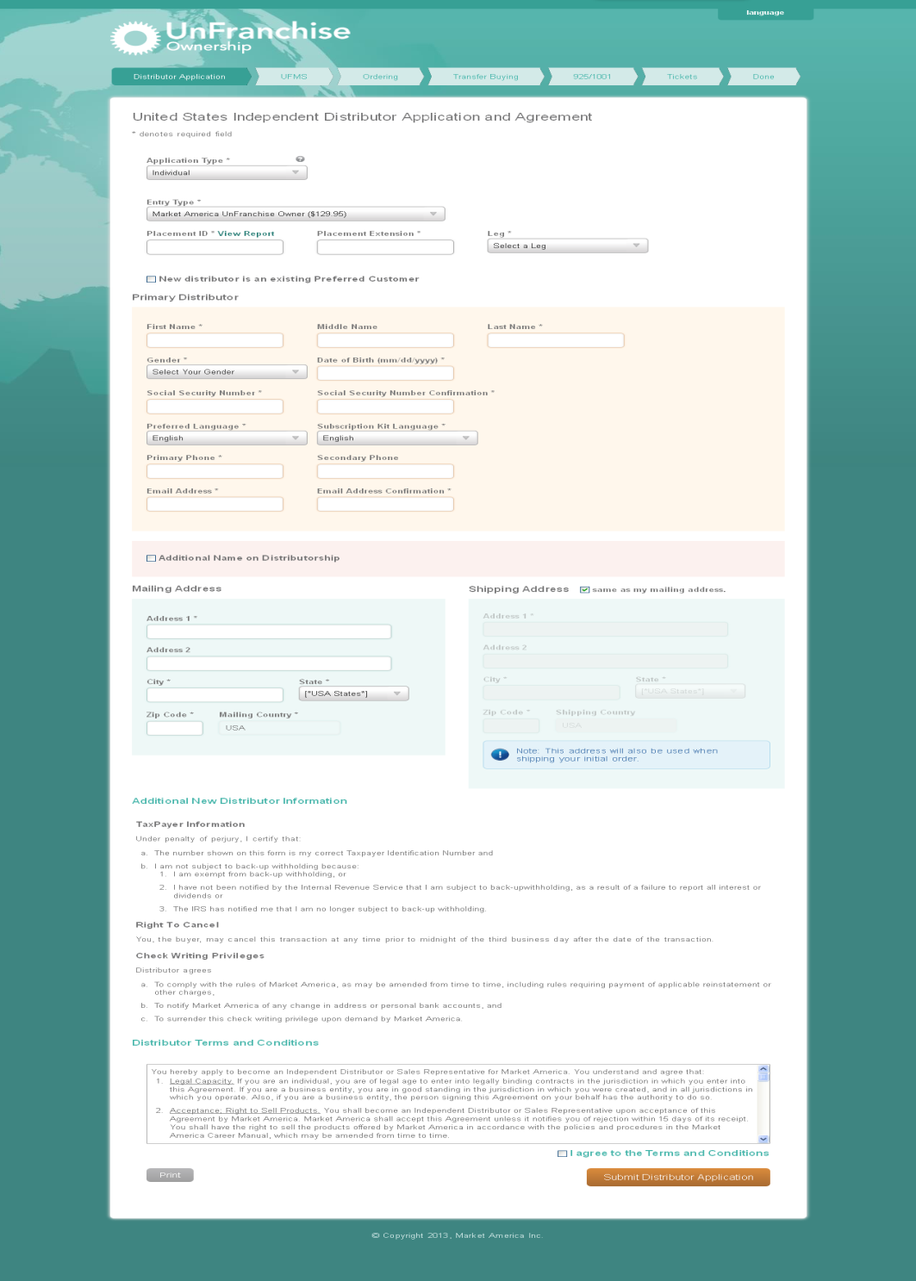
現在，我們顯示組織網絡報告，而不再顯示可放置經銷商的位置
入會登記窗口亦加入全新的錯誤檢查功能（即時驗證），簡單易用
We now show genealogy reports instead of open placement.
There is also new error checking — Inline validation, which is easy to understand.

Slide 18
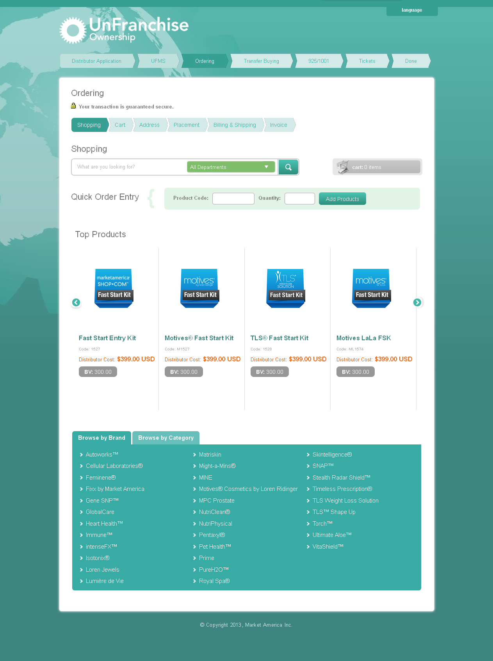
訂購版面：
各個快速起步套裝顯示於版面上方，方便選擇
新訂購程序具有全新、準確的搜尋功能
Ordering Screen:
The Fast Start Kits are displayed up front for easy selection.
The new ordering process has a new, accurate search function

Slide 19
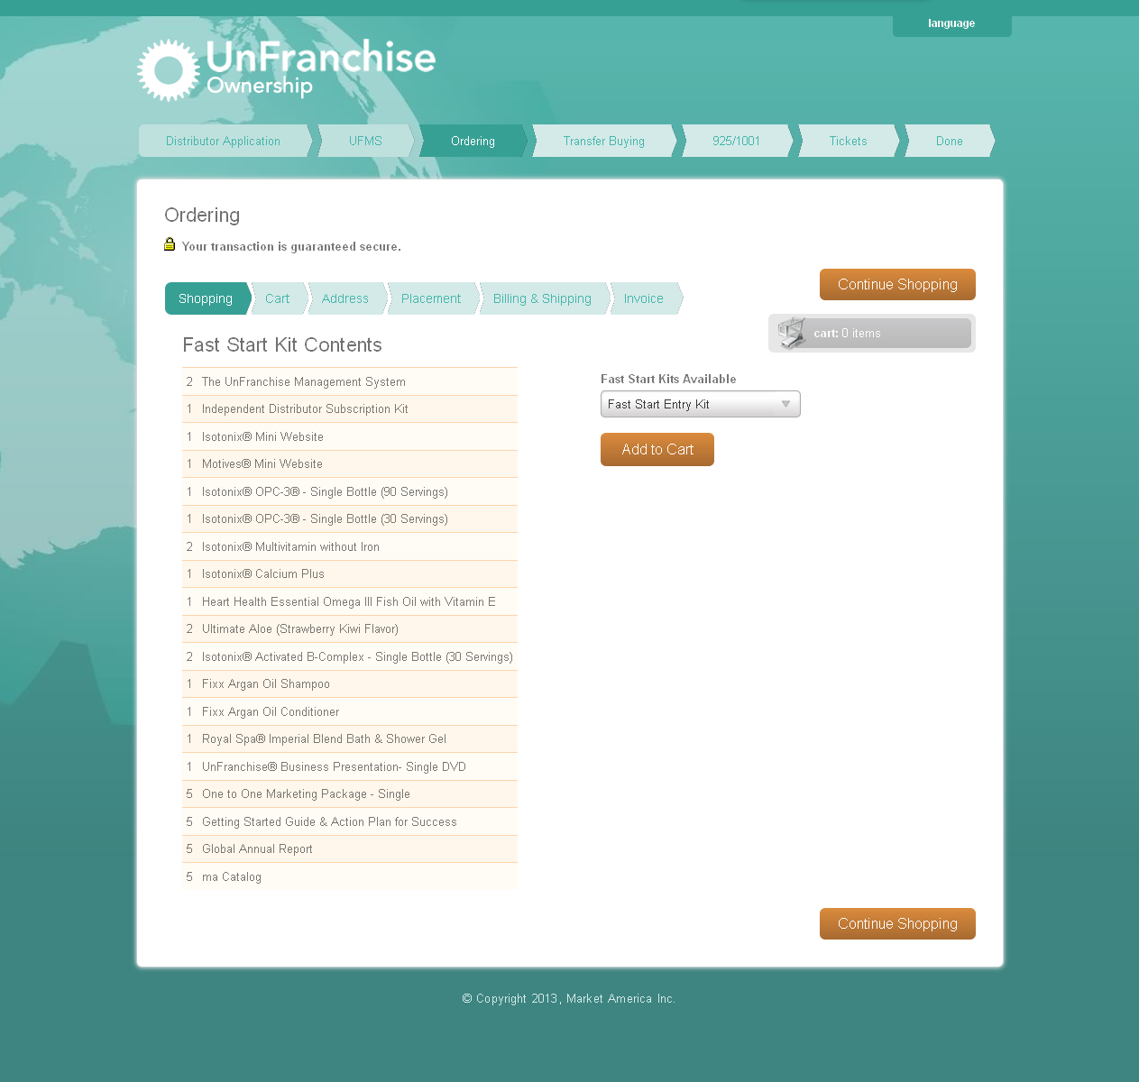
只需點擊快速起步套裝連結，即會顯示套裝簡介
By clicking on a Fast Start Kit link, the description for that kit is displayed.

Slide 20




快速起步套裝！
Fast Start Kit!
助新事業夥伴起步
Get a New Business Partner Started!
USD$399
超連鎖事業（300 BV及3個商業發展中心）
獨立經銷商入會資料套裝
建立事業資料
網路中心 – 由美安網路中心專業團隊支援
Master UnFranchise Business
(300 BV & 3 BDCs)
Independent Distributor Subscription Kit
Business Building Materials
maWebCenter – backed by maWebCenters Teams of Professionals
Notes:
JF

Slide 21
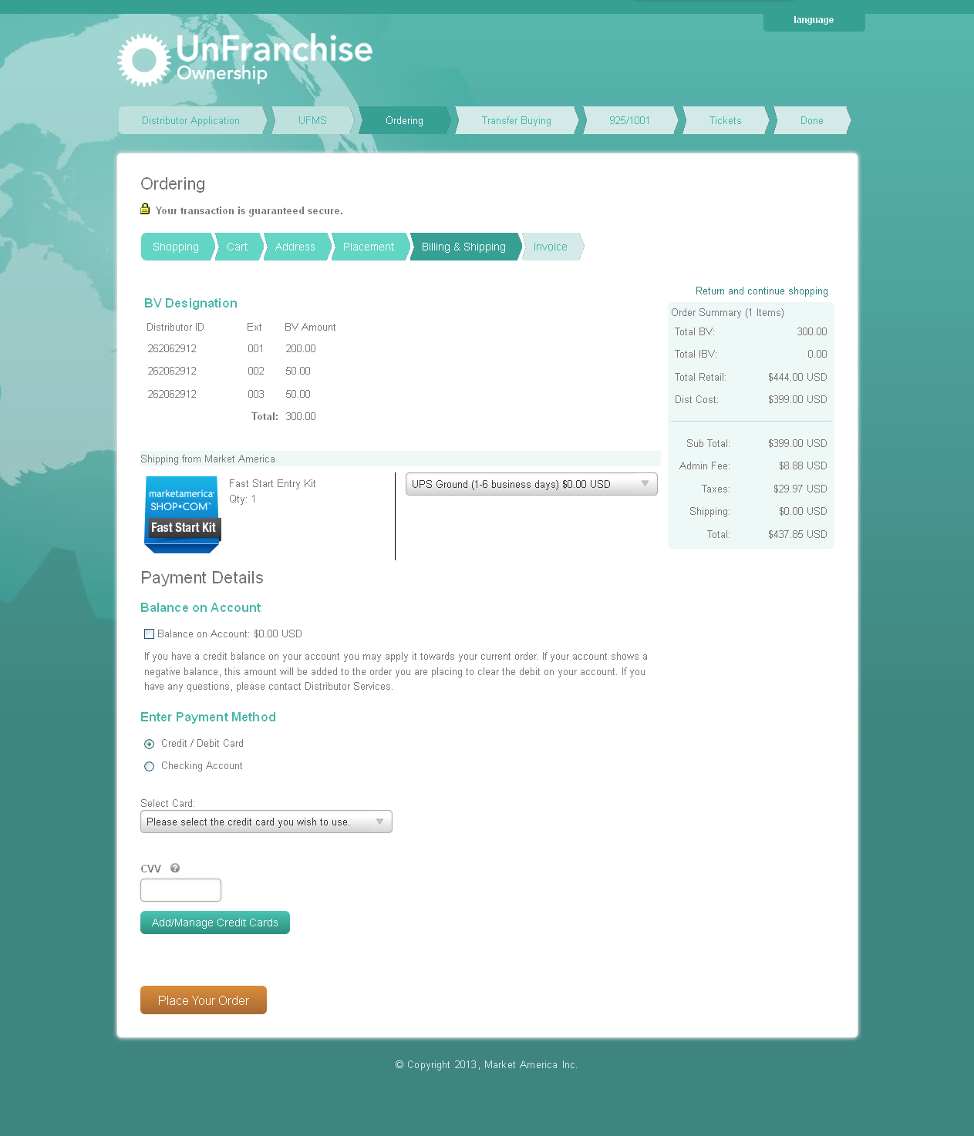
整體來說，購物程序已作調整，與現有的購物過程相似
Overall, the shopping flow has changed to become more aligned with the conventional shopping experience.

Slide 22
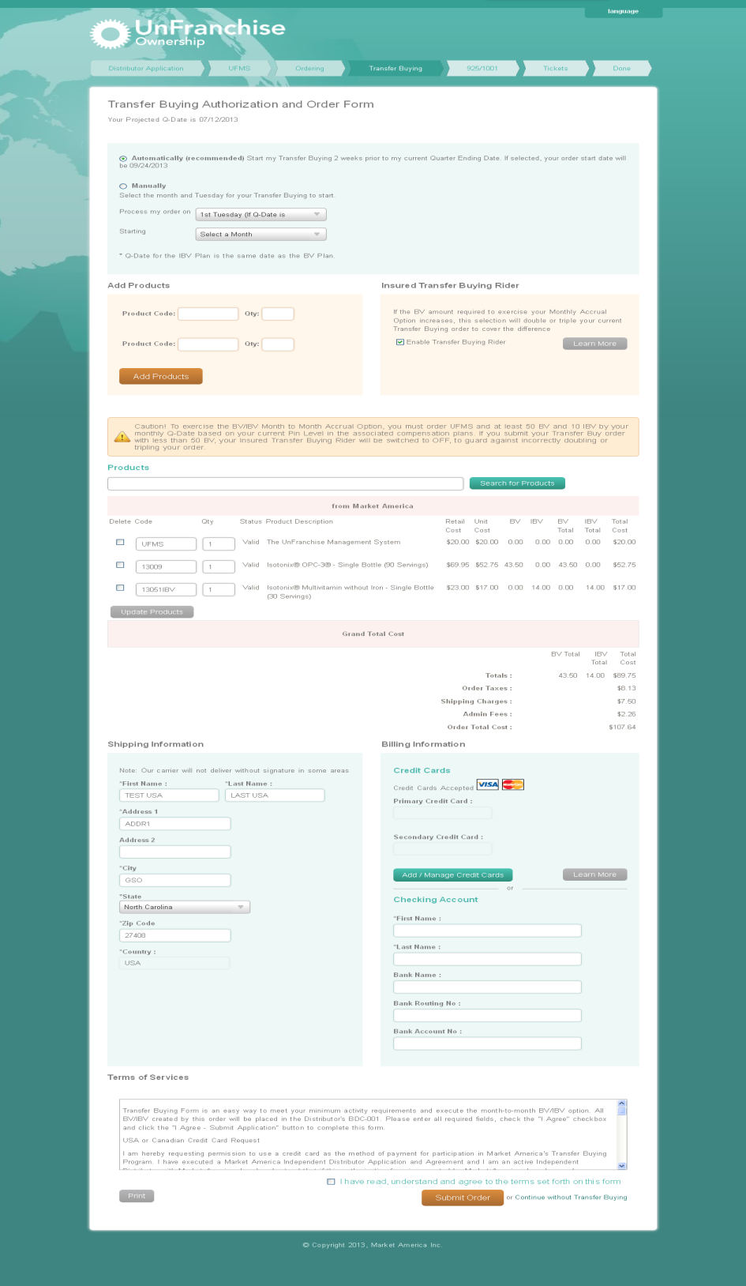
自動購貨
全新改良搜尋功能
訂購產品 – 使用更簡易
加入BV/IBV最低要求與超連鎖事業管理系統最低要求的警示
Transfer Buying
New and better search functionality
Product ordering - better user experience
Dynamic warning for minimum BV/IBV and UFMS has been added.

Slide 23
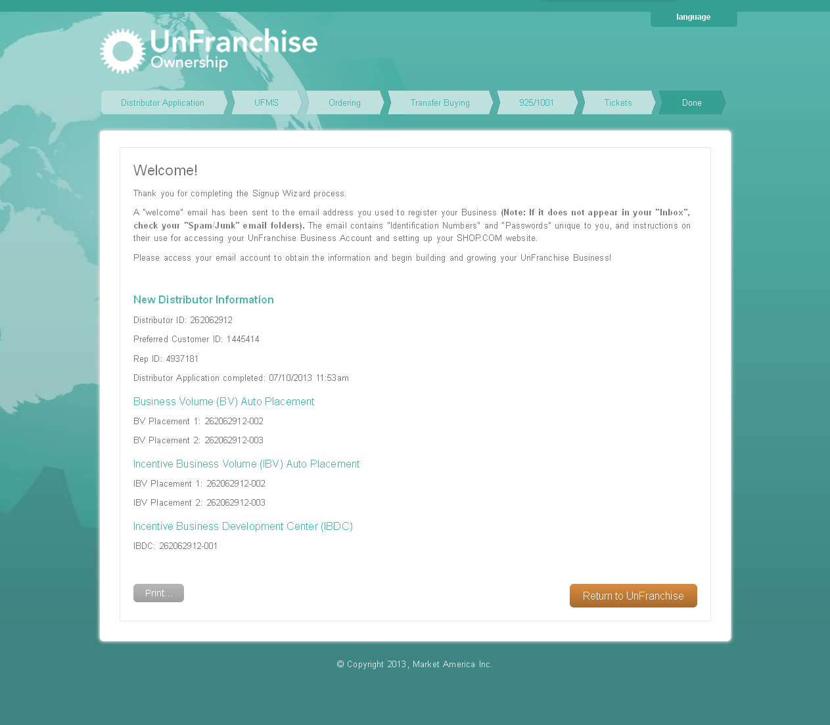
完成版面：我們將002與003設定為BV自動放置中心與IBV自動放置中心
001則設定為獎勵業績商業發展中心(IBDC)
這些設定會自動於登記過程進行，並於完成頁面列出以讓經銷商留意此預設設定
經銷商可隨時於unfranchise.com變更設定
Completed screen: We are setting the BV auto placement and IBV auto placement to the 002 and 003.
The IBDC will be set to 001.
This information is done automatically during signup and will be displayed at the completion screen to make the Distributor aware of this default setting.
The Distributor can always go back and make changes on unfranchise.com.

Slide 24
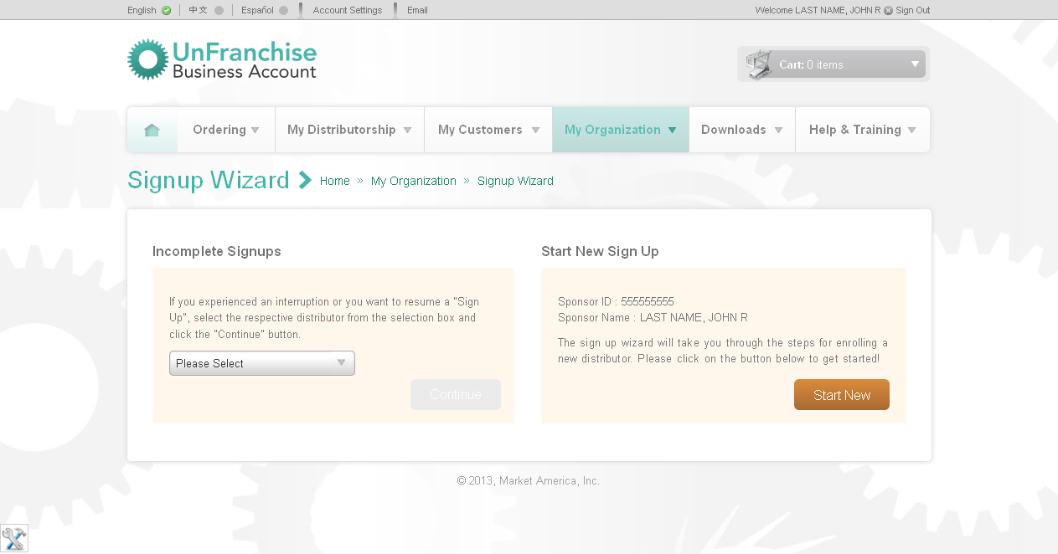
推薦人現在亦可回到入會登記窗口的登錄版面，當他／她完成登記新經銷商後，只需點擊「回到超連鎖事業管理系統」，即可直接開始為另一位新經銷商登記，而無需再回到unfranchise.com
We also allow the Sponsor to go back to the SUW landing screen, once he/she is done registering a new UFO, by clicking on ‘Return to UnFranchise,' so that he/she can start registering a new UFO directly instead of having to log back in to unfranchise.com.

Slide 25

放假
Relaxing

Slide 26

工作
Working ☺

Slide 27
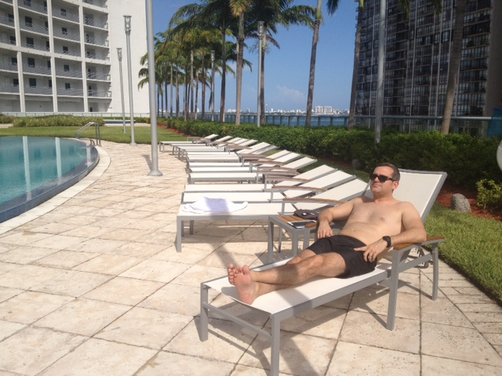
放假
Relaxing

Slide 28
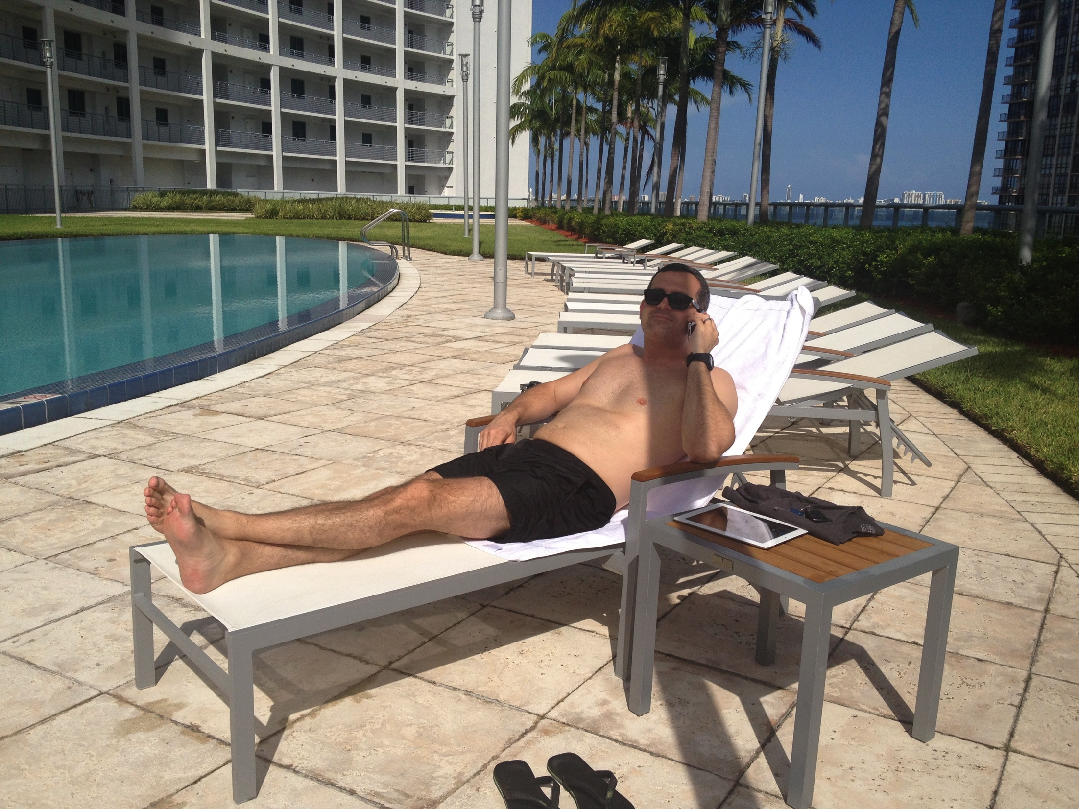
工作
Working ☺

Slide 29
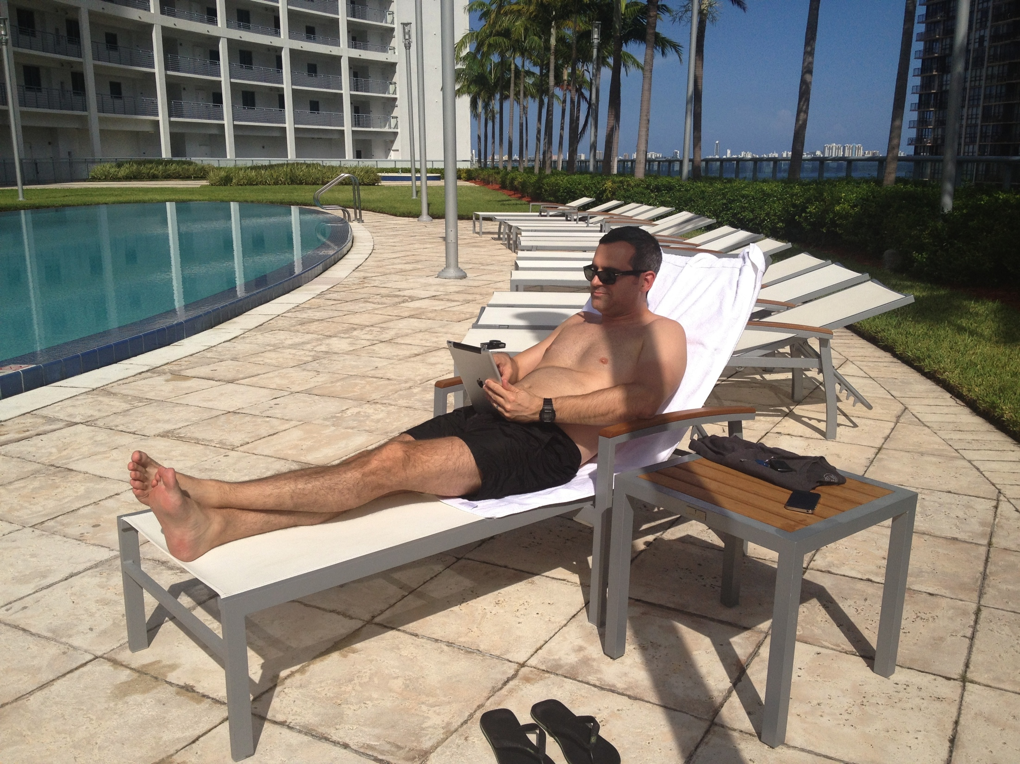
Placed a new Partner ☺
Simplify

Slide 30
放假
Relaxing

Slide 31
全新超連鎖事業簡報短片
New UnFranchise Business video

Slide 32
超連鎖事業簡報短片
超連鎖事業簡報 (22:36)
美安香港及HK.SHOP.COM概要 (4:28)
產品分銷及互聯網行銷 (3:25)
水平行銷 v.垂直行銷 (1:35)
5個建立超連鎖事業的步驟 (13:03)
YouTube
UnFranchise Business video
The UnFranchise Business Presentation (22:36)
Market Hong Kong & HK.SHOP.COM overview (4:28)
Product Brokerage & Internet Marketing (3:25)
Horizontal v. Vertical (1:35)
Five Steps to Build an UnFranchise Business (13:03)
YouTube

Slide 33
如何運用超連鎖事業簡報短片
用「概要」短片作為開始介紹，社交媒體
全新9:30短片
家庭事業簡報會 (HBP)
一對一，二對一會議
跟進
How to Use the UBP videos
Use ‘Overview’ as introduction, social media
New 9:30 video
HBP
1 on 1, 2 on 1 meetings
Follow up

Slide 34
全新超連鎖事業簡報短片
已經推出！
New UnFranchise Business video
It’s ready NOW!

Slide 35
Show Video Preview

Slide 36

美安香港YouTube頻道：
YouTube.com/
markethongkongvideos

Slide 37

Copyright © 2013 美安公司

Slide 38
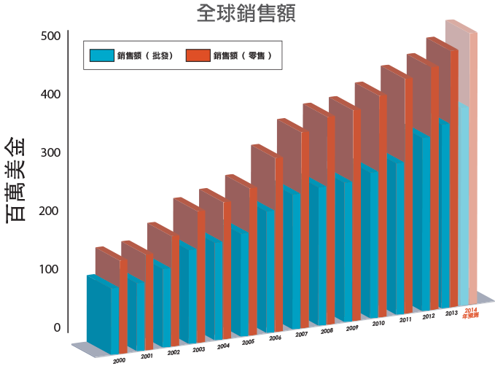
估計累積零售額 †:
$5,311,649,699*
*從公司創立至2013年6月30日止
†估計累積零售額根據建議零售價計算
Notes:
38

Slide 39
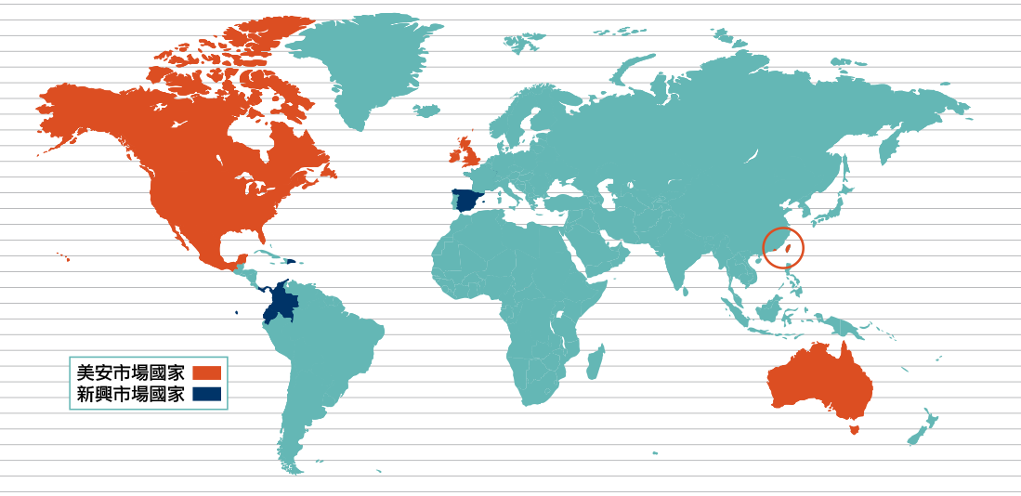


Slide 40


Slide 41


Slide 42


嬰幼兒護理

Slide 43


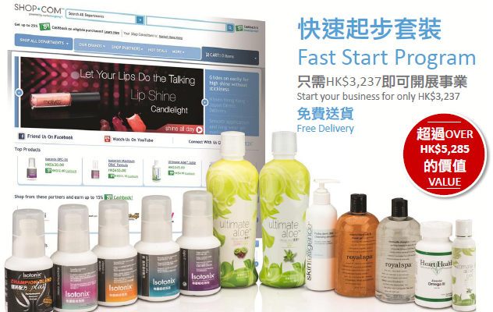
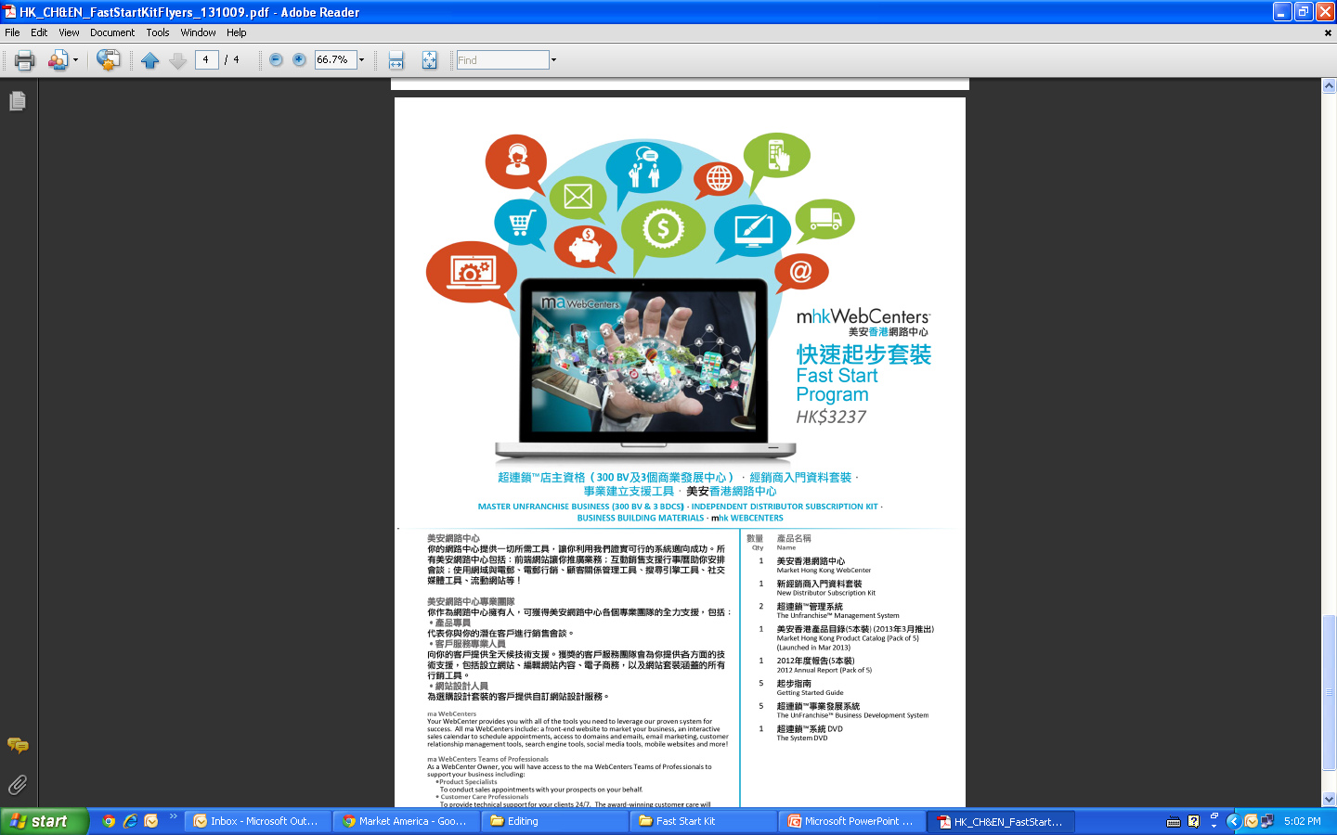
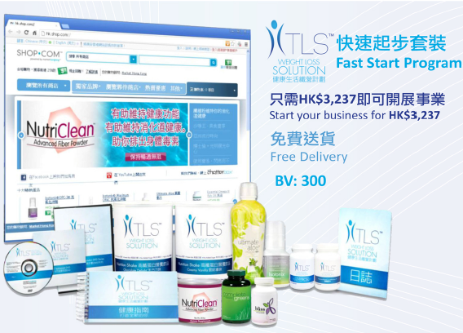


Slide 44

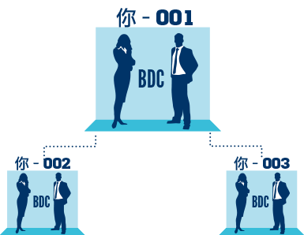
加入費用包括：
HK.SHOP.COM網站
GLOBAL.SHOP.COM網站
Isotonix®及Motives®網站
超連鎖™事業帳戶
專業手冊
起步指南手冊
Powerline月刊（超連鎖創業專刊）
會議聯盟系統的支援，獲得經驗豐富的超連鎖店主培訓與指導

Slide 45

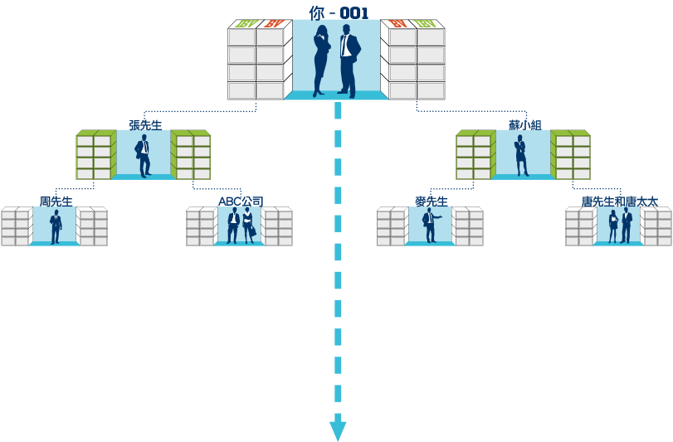





不斷引進更多新經銷商
*綠色表示個人推薦經銷商

Slide 46
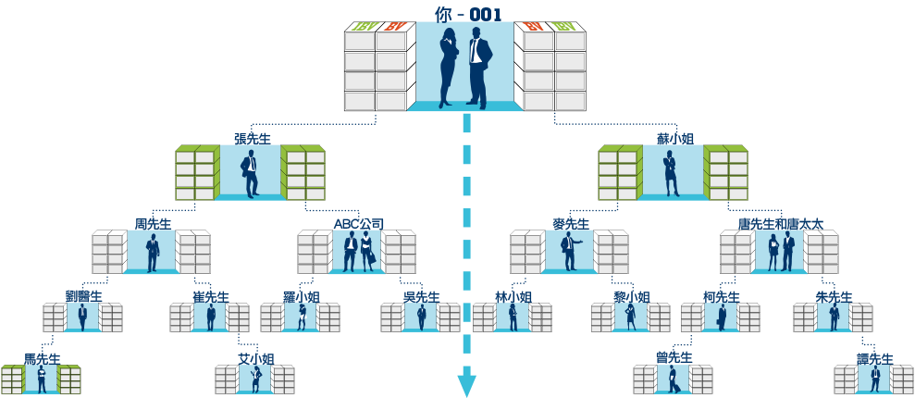

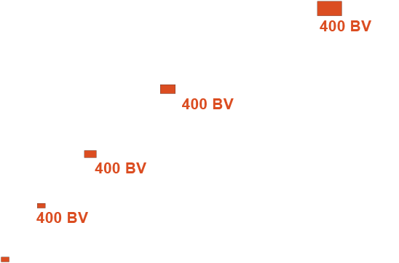
舉例：你有一張訂單，有400BV可以放置
400 BV
*業績點數可以放置於你個人推薦經銷商的商業發展中心

Slide 47
化繁為簡及提升
Simplify & Improve

Slide 48
更新起步指南
Updated Getting Started Guide

Slide 49

Notes:
YOU GET PEOPLE TO LEAD YOU TO THE RIGHT PEOPLE THROUGH TRIAL RUNS>>>>TEST MARKETING
USING EVALUATION APPROACH
SHOW THE PROGRAM
DETERMINE IF THEIR CONTACTS KNOW THE RIGHT PEOPLE
TEST MARKET THE PRODUCT

Slide 50
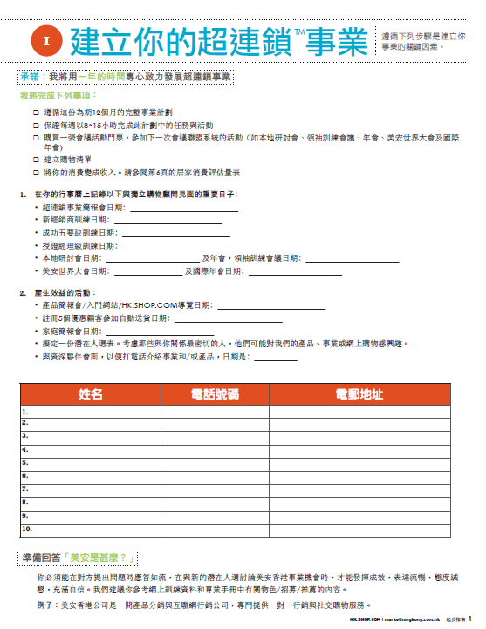
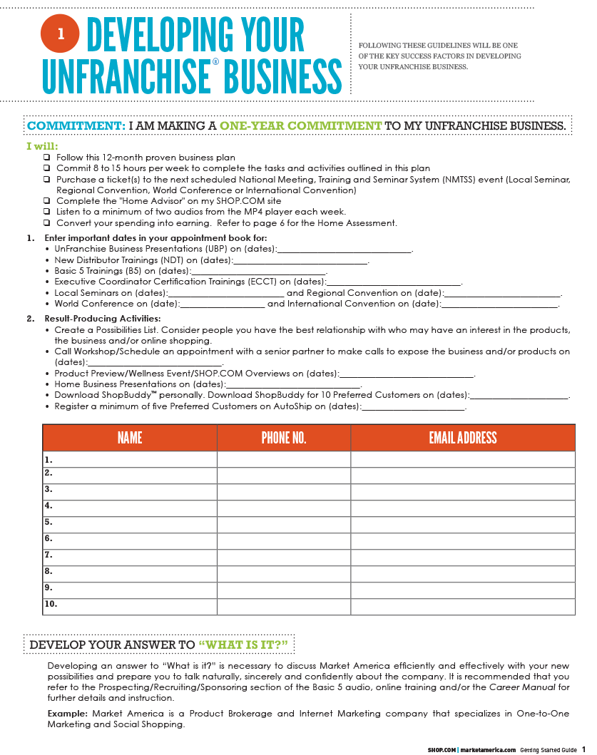
Notes:
YOU GET PEOPLE TO LEAD YOU TO THE RIGHT PEOPLE THROUGH TRIAL RUNS>>>>TEST MARKETING
USING EVALUATION APPROACH
SHOW THE PROGRAM
DETERMINE IF THEIR CONTACTS KNOW THE RIGHT PEOPLE
TEST MARKET THE PRODUCT

Slide 51
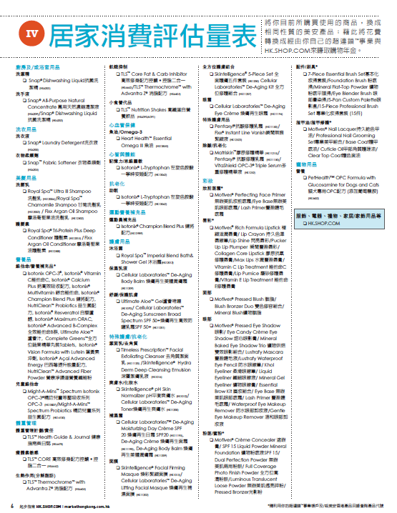
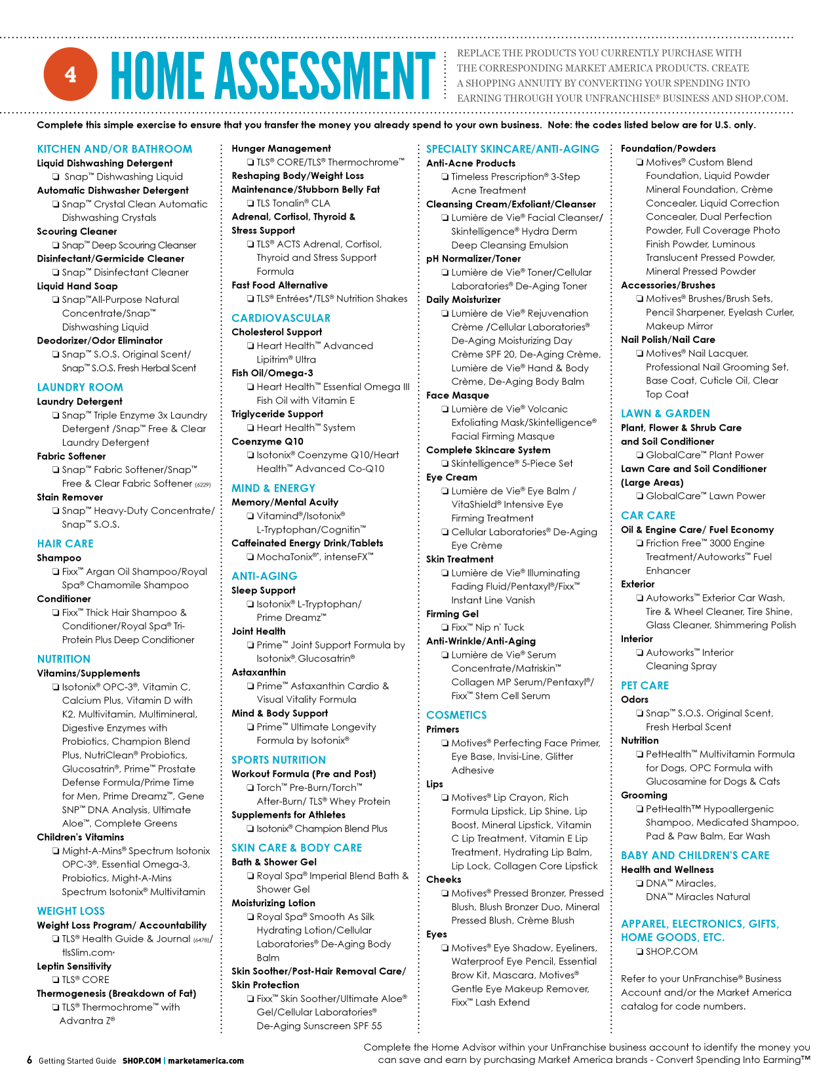
Notes:
YOU GET PEOPLE TO LEAD YOU TO THE RIGHT PEOPLE THROUGH TRIAL RUNS>>>>TEST MARKETING
USING EVALUATION APPROACH
SHOW THE PROGRAM
DETERMINE IF THEIR CONTACTS KNOW THE RIGHT PEOPLE
TEST MARKET THE PRODUCT

Slide 52
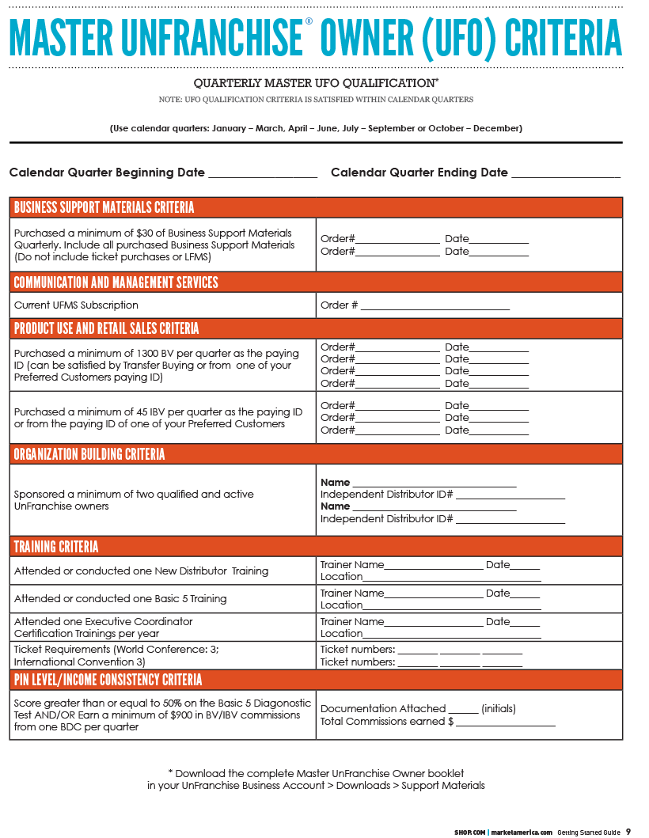

主管超連鎖店主計劃
表格
快將更新！
Notes:
YOU GET PEOPLE TO LEAD YOU TO THE RIGHT PEOPLE THROUGH TRIAL RUNS>>>>TEST MARKETING
USING EVALUATION APPROACH
SHOW THE PROGRAM
DETERMINE IF THEIR CONTACTS KNOW THE RIGHT PEOPLE
TEST MARKET THE PRODUCT

Slide 53
全新起步指南
New Getting Started Guide
UnFranchisetraining.com
包括於經銷商入門套裝及快速起步套裝內
超連鎖事業帳戶
UnFranchisetraining.com
Included in the subscription kit & Fast Start Kit
UnFranchise business account

Slide 54
化繁為簡及提升
Simplify & Improve

Slide 55
產品組合套裝
Product Packages

Slide 56




SAVE
33%
SAVE
32%
高效營養組合
Optimal Wellness Kit
Isotonix®基本營養組合
Isotonix® Daily Essentials Kit
SAVE
25%
SAVE
24%
精叻兒童系列－至「營」iKids套裝
Might-A-Mins Spectrum-
iKids Nutrition Combo
全方位DETOX纖營組合
Complete Cleansing and
Detoxification Kit

Slide 57




下載–健康與營養及其他產品–宣傳單張
Downloads – Health & Nutrition and other products – Flyer

Slide 58
About Market America & SHOP.COM pdf

Slide 62


Slide 65
About Market America & SHOP.COM
Where to find it…
UnFranchise business account – downloads – support materials – sales aides
Front page marketamerica.com

Slide 66
化繁為簡及提升
Simplify & Improve

Slide 67
產生效益的活動
使用及銷售產品
宣傳事業
賣票
在家工作
Result Producing Activities
Use and sell the Products
Introducing the Business
Sell Tickets
Work in the homes

Slide 68






你一定要有的3張門票！
Get Your 3!
總值
HK$3,690
VALUE
接近
30% OFF
Almost
“I Got My 3”禮品：
Isotonix® OPC-3®
Isotonix® 葉黃素沖劑一瓶 Vision Formula with Lutein
美安香港網路中心 mhk WebCenter
基礎維他命組合 Foundation Vitamin Pack：
Isotonix® 綜合維他命 Multivitamin
Isotonix® 全效維他命B群 Advanced B-Complex
Isotonix® 維他命C Vitamin C

Slide 69


Slide 70
.
Notes:
70

